Slide 1
Recorder Hero!
6.111 Final Project
Paul Hemberger, Andres Romero

Slide 2


Slide 3

http://www.hightech-edge.com/guitar-hero-3-legends-of-rock-xbox-games/1468/

Slide 4
SCORE: 54013
PITCH: C
C
B
A
G
F
E
D
C

Slide 5
Technical Overview
FFT
Game State Machine
Video
Musical Score
Picture of flow of information

Slide 6
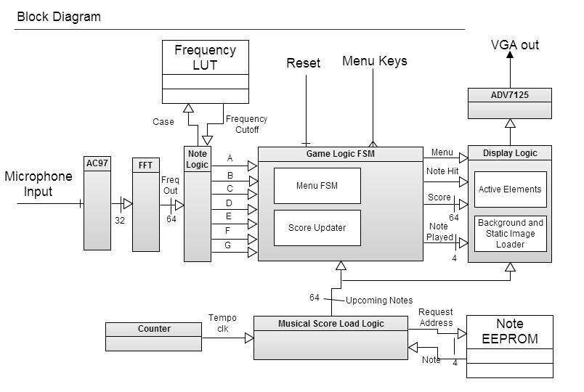
Overall Block Diagram

